Slide 1
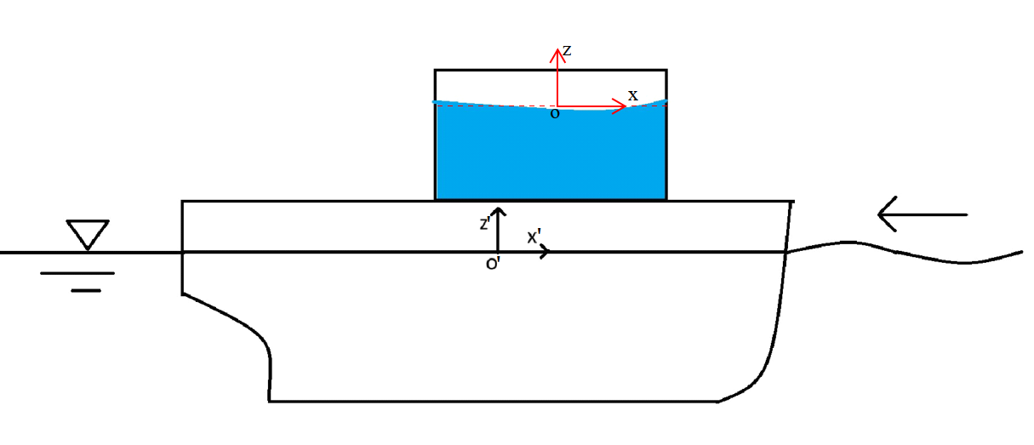
A Sloshing problem
In a non-inertial/body-fixed frame: Analytical Solution v.s. Numerical

Slide 2

Neumann BVP
$$\left\{\begin{aligned}∇^{2}φ=0, \left(x,z\right)∈\left[−\frac{l}{2},\frac{l}{2}\right]×[−z_{t},0] \\ \int_{−\frac{l}{2}}^{\frac{l}{2}}{ζ\left(x,z\right)dx=0, } F.S. or Continuity \\ {\left.\frac{∂φ}{∂z}\right|}_{z={−z}_{t}}=0, T.B.B.C. \\ {\left.\frac{∂φ}{∂x}\right|}_{x=±\frac{l}{2}}=v_{o}+ω⋅r=v′, B.B.C \\ \frac{∂^{2}φ}{∂t^{2}}+g\frac{∂φ}{∂z}=?, F.S.B.C\end{aligned}\right.$$

Slide 3
Neumann BVP - Tasks
Formulize the linear pressure.
fluid particle velocity at an off-body point (x, z, with z<=Z_{t}) inside the tank.
Explain how to incorporate the formula to extend WADAM program so that they can handle this problem.

Slide 4

Neumann BVP – Tasks (from the most general form)
Since Bernoulli’s equation is integral of the pressure gradient
$$∇p=−ρ\frac{∂∇φ}{∂t}−ρ\left(\frac{1}{2}∇{|v|}^{2} −g+a_{O}+\dot{ω}×r+ω×(ω×r)\right)$$
Fluid particle velocity (x, z) needs the velocity potential
The Neumann BVP if solved, will give all we need.

Slide 5
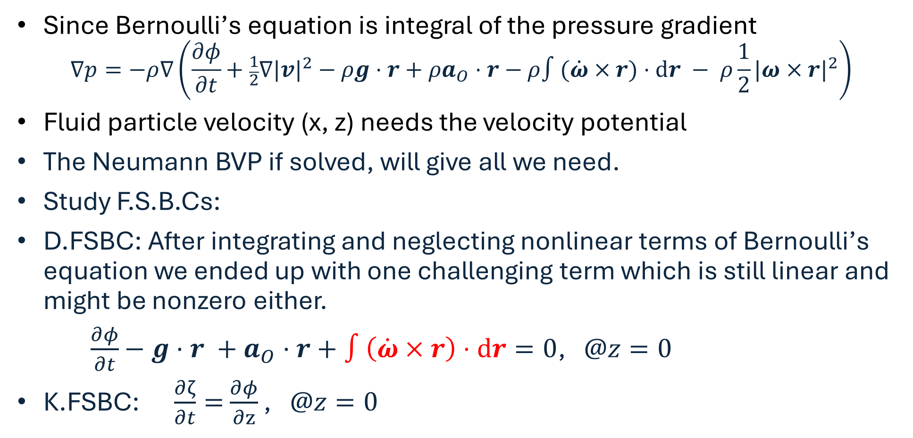
Neumann BVP – the most general form
Since Bernoulli’s equation is integral of the pressure gradient
$$∇p=−ρ∇\left(\frac{∂φ}{∂t}+\frac{1}{2}∇{|v|}^{2}−ρg⋅r+ρa_{O}⋅r−ρ∫(\dot{ω}×r)⋅dr − ρ{\frac{1}{2}|ω×r|}^{2}\right)$$
Fluid particle velocity (x, z) needs the velocity potential
The Neumann BVP if solved, will give all we need.
Study F.S.B.Cs:
D.FSBC: After integrating and neglecting nonlinear terms of Bernoulli’s equation we ended up with one challenging term which is still linear and might be nonzero either.
$\frac{∂φ}{∂t}−g⋅r +a_{O}⋅r+∫\left(\dot{ω}×r\right)⋅dr=0$, $@z=0$
K.FSBC: $\frac{∂ζ}{∂t}=$ $\frac{∂φ}{∂z}$ , $@z=0$

Slide 6

Neumann BVP – Combined FSBC
Assume harmonic velocity potential can be expressed as
$Φ(x,z;t)=ℜ\left[φ(x,z)e^{−iωt}\right]$, then
$$−ω^{2}φ+g\frac{∂φ}{∂z}=−\frac{∂}{∂t}\left(a_{O}⋅r \right)=−iω^{3}ξ_{O}⋅r$$
$ξ_{O}$is the oscillation amplitude of the origo.

Slide 7
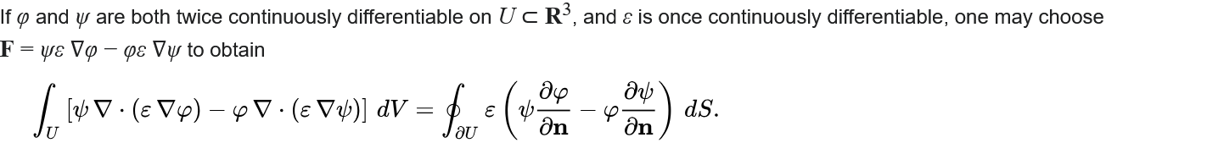

Numeric Solution based on Green’s 2nd Identity
For simplicity, we use the $ε=1$

Slide 8
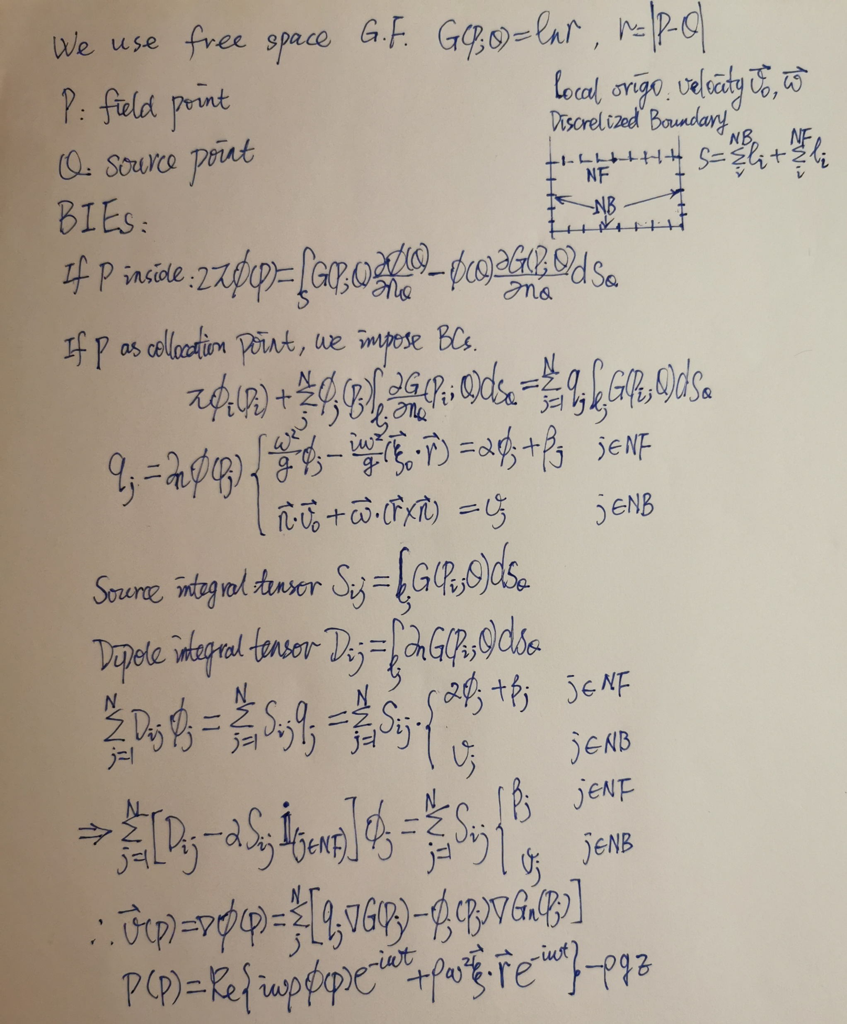
Boundary Integral Equations

Slide 9

Build up linear equation system and solve

Slide 10
Implement into Wadam/BEM?
! 1. Input geometry and gridding
CALL BEM_GRID(npanels)
! 2. Input motion parameters
TYPE(ShipMotion) :: motion
motion%frequency = …! Hamonic frequency
motion%v_surge = ... ! Surge velocity
motion%a_surge = ... ! Surge accleration
…
! 3. Calculalte GF
SUBROUTINE GREEN_FUN()
…
! 4. Solve the linear system Ax=b
…
! 5. Calculalte velocity and pressure at the given field point
…

Slide 11
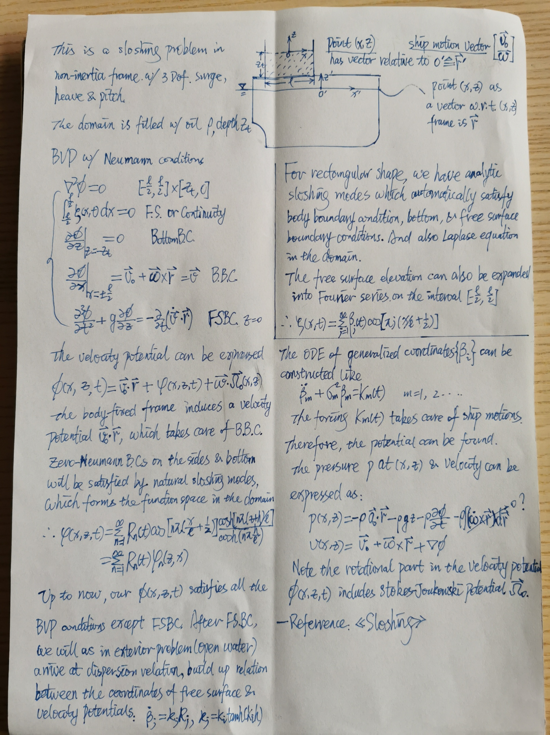
Alternative Modal Expanded Analytical Solution

